Slide 1


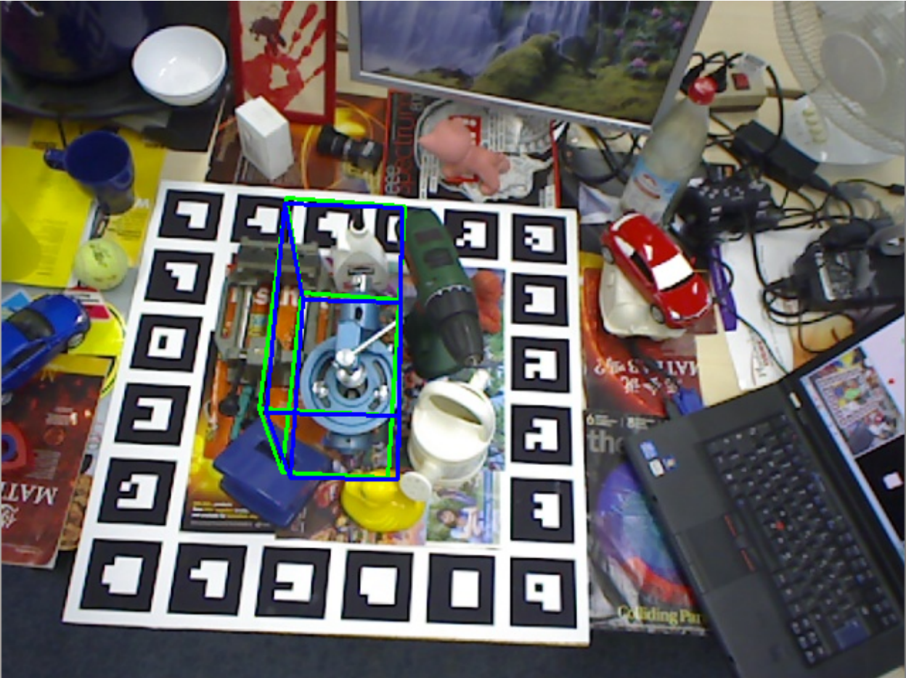
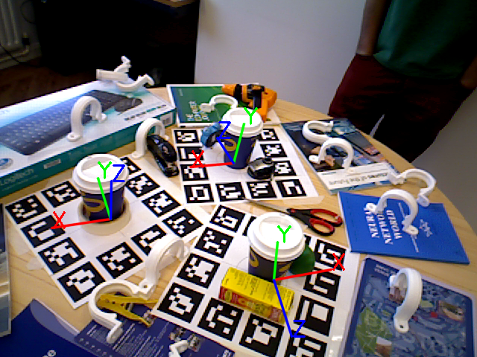
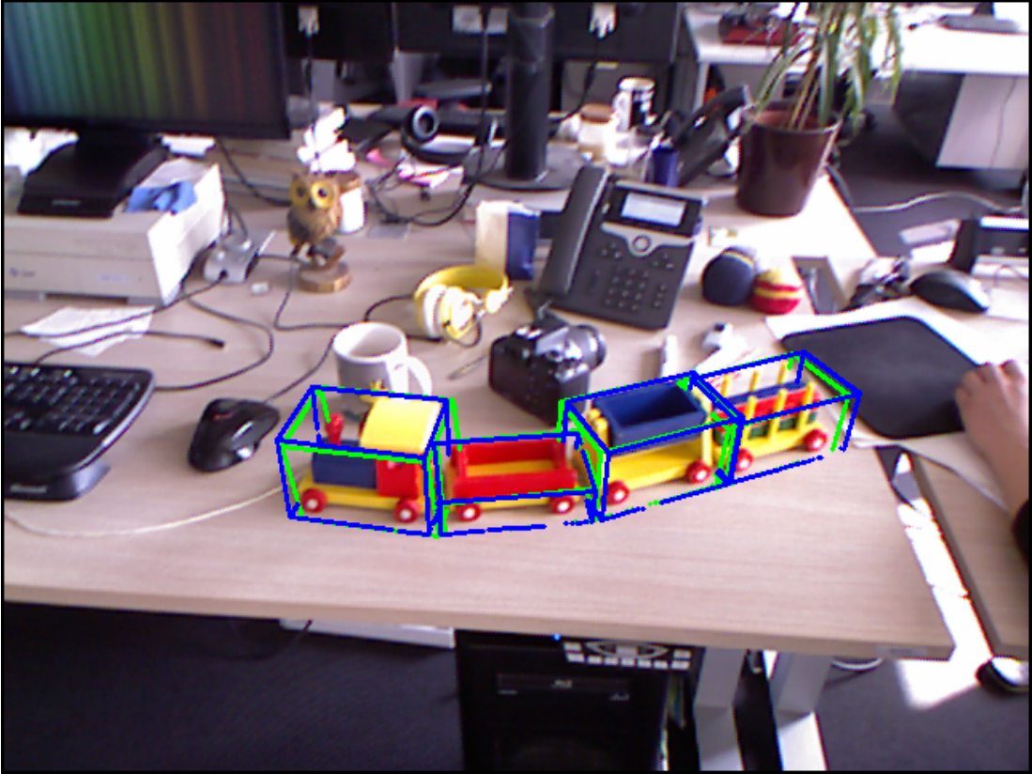
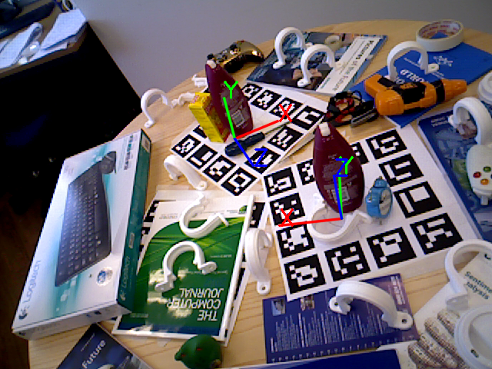
ICCV Workshop on Recovering 6D Object Pose
Tae-Kyun Kim, Carsten Rother, Vincent Lepetit, Jiri Matas, Ales Leonardis, Rigas Kouskouridas
December 17th, 2015

Slide 2
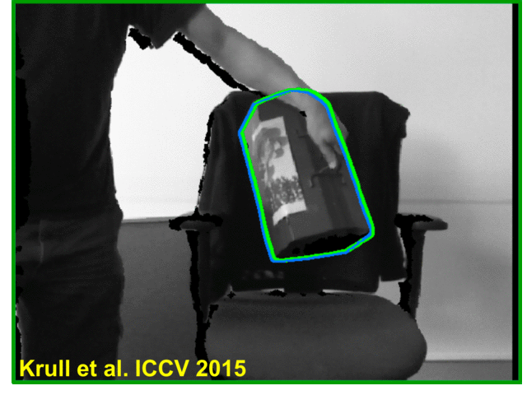
Aims and Scope
First attempt at gathering researchers who work on object recognition, detection and pose estimation problems.
Offer a series (6) of challenges / datasets that cover several testing scenarios that include:
Background clutter
Foreground occlusions
Large scale changes
Illumination changes
Textureless objects
Our program features several high-quality invited talks, poster presentations and demos.

Slide 3
Statistics
12 extended abstracts have been submitted, and they are presented as spotlights and posters.
2 demos on site for 6D object pose recovery.
We will present the best poster award ($200) sponsored by

Slide 4
People
Organisers
Tae-Kyun Kim, Imperial College London
Carsten Rother, Technical University Dresden
Vincent Lepetit, Technical University Graz
Jiri Matas, Czech Technical University
Ales Leonardis, University of Birmingham
Rigas Kouskouridas, Imperial College London
Invited Speakers
Justus Piater, University of Innsbruck
Kostas Daniilidis, University of Pennsylvania
Yu Xiang, University of Michigan (joint work with Silvio Savarese)
Challenge Chairs
Andreas Doumanoglou, Imperial College London
Frank Michel, Technical University Dresden
Alexander Krull, Technical University Dresden
Ales Leonardis, University of Birmingham
Alberto Crivellaro, EPFL
Tomas Hodan, Czech Technical University

Slide 5
Challenge University of Birmingham (UoB) Highly Occluded Object Challenge

Slide 6


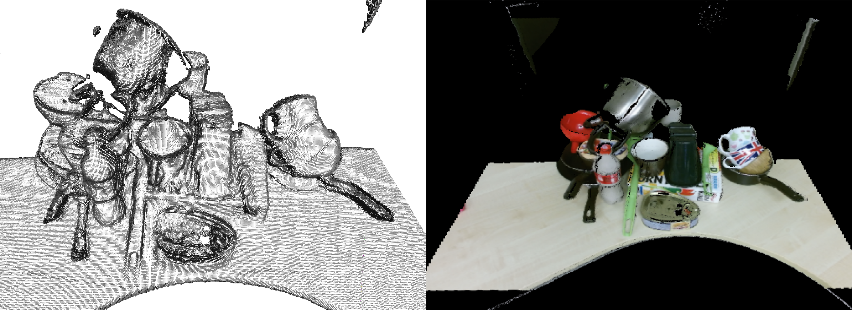
The Challenge
UoB Highly Occluded Object Challenge provides a dataset and an evaluation protocol for:
object detection (categorisation)
scale and pose estimation
from point-cloud data captured with three Kinect v2 sensors.

Slide 7
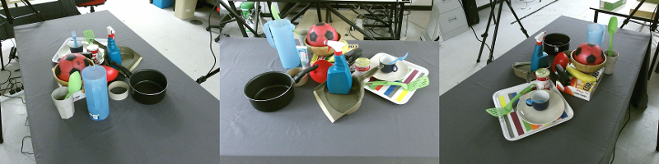
Properties of the Scenes
The scenes contain:
up to 20 objects
selected from 25 categories
in very challenging scenarios with:
high levels of occlusions
numerous symmetric objects

Slide 8
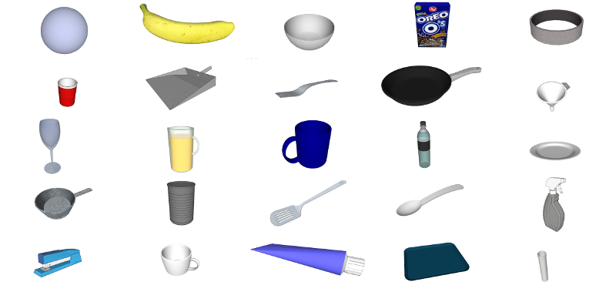
Object Categories
Consist of a set of computer graphics models of household objects:
25 categories (generic)
5 instances per category

Slide 9
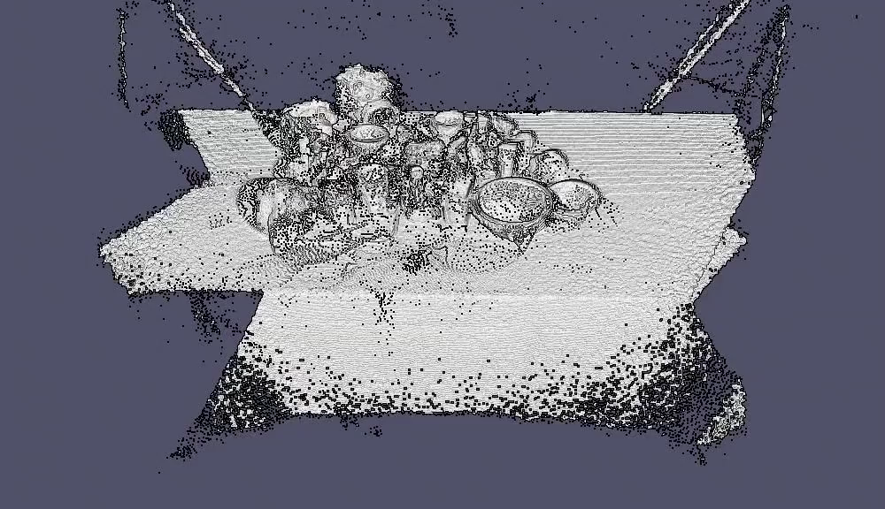
Test Procedure
Place the correct computer graphics models at appropriate locations in a given point-cloud:
detect objects
establish their pose and
scale
Evaluation process (full annotations, evaluation measures):
Classification accuracy
Average Distance (AD) between the 3D model in the estimated pose and the ground truth
Symmetry aware Improved Average Distance (IAD) measure

Slide 10
Summary
A very challenging dataset
High levels of occlusions (quantified)
Training and test sets of objects are very different
Some of the test objects are semi-transparent
Various plans for extending the challenge

Slide 11
Challenge Imperial College London (ICL) Multi-instance & Bin-picking Object Challenge

Slide 12
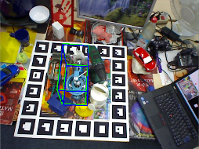

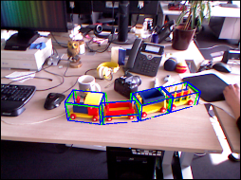

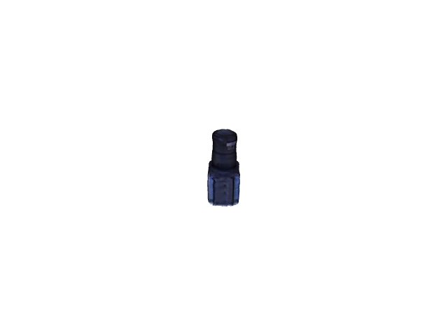
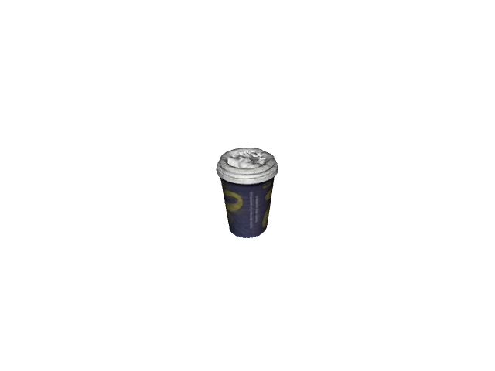
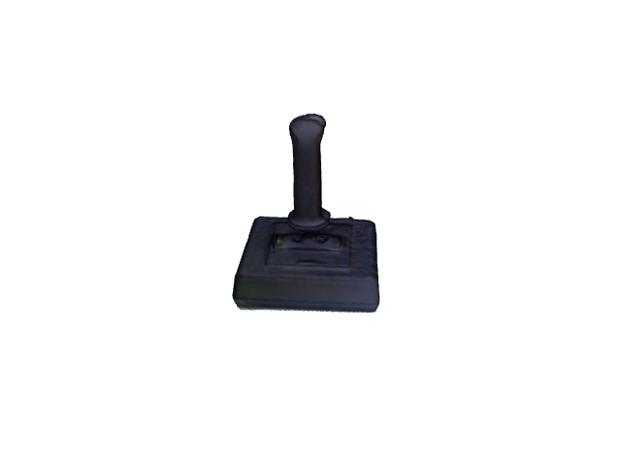
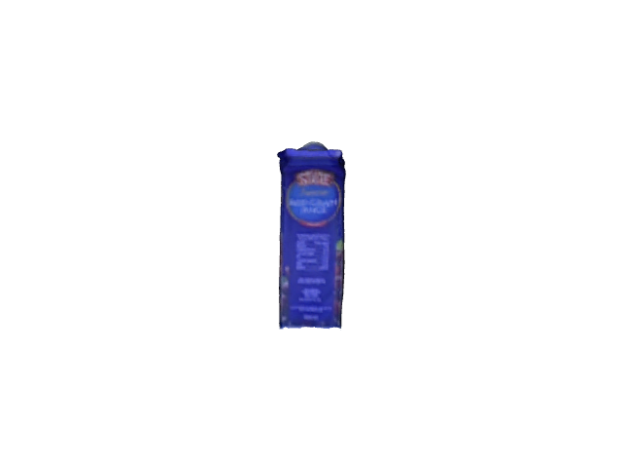
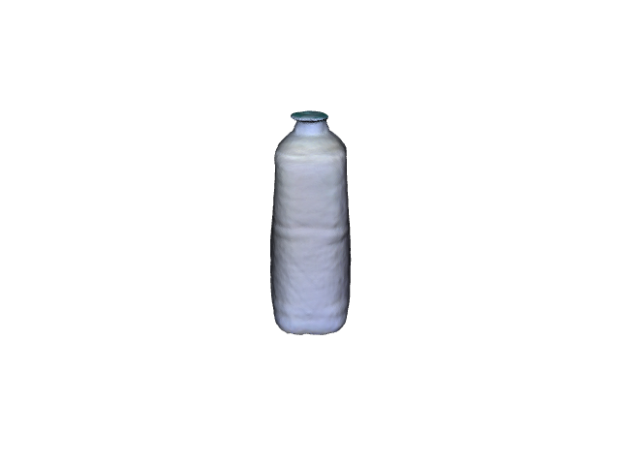
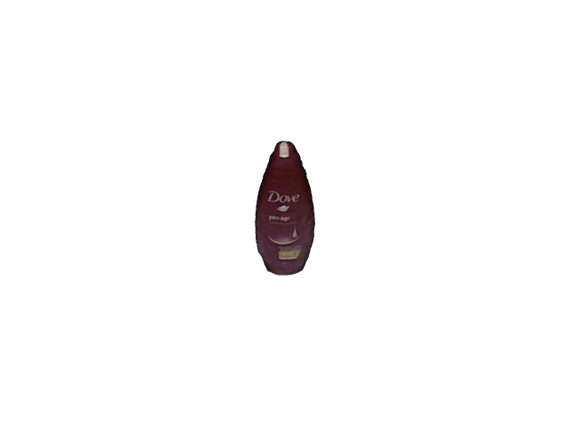
Multi-Instance Dataset
A. Tejani, D. Tang, R. Kouskouridas, T-K. Kim, Latent-Class Hough Forests for 3D Object Detection and Pose Estimation, ECCV 2014
3D models captured with Scanect using Xtion.
Camera
Coffeecup
Joystick
Juice Box
Milk Box
Shampoo

Slide 13
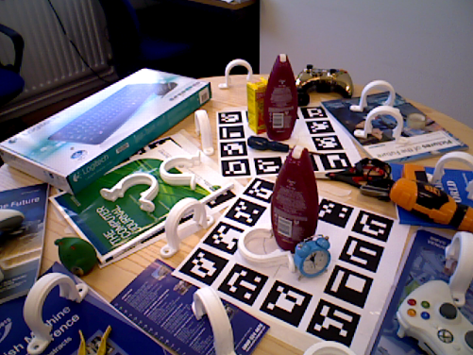
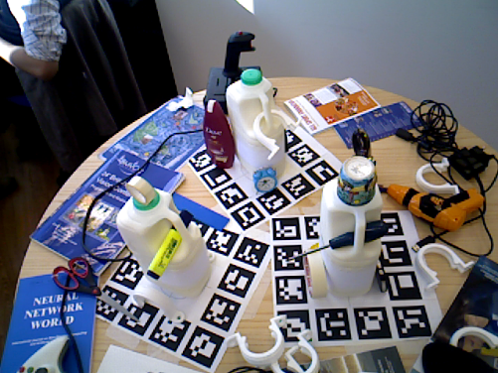
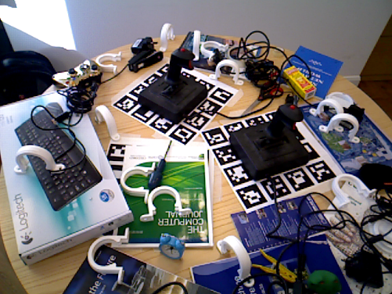
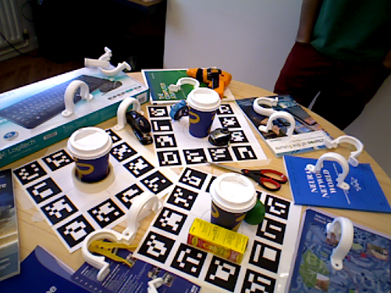
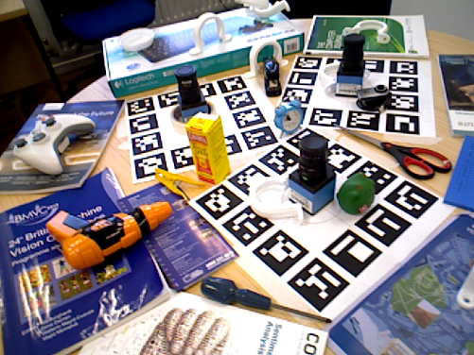
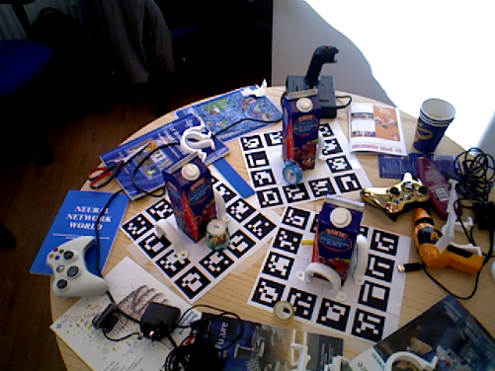
Multi-Instance Dataset
Multiple instances present in a scene
Cluttered Background
Partial Occlusions
~800 test images per item
Captured with Xtion

Slide 14
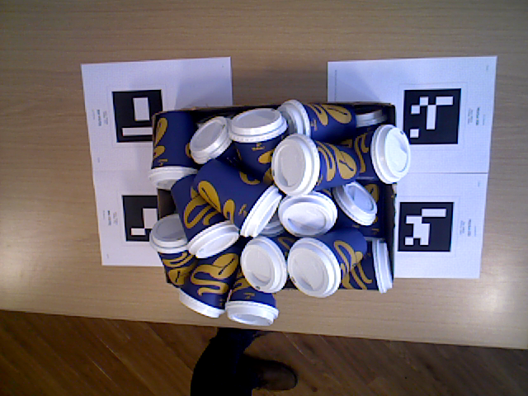
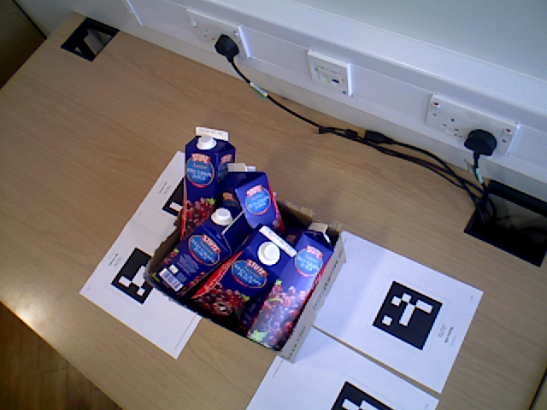
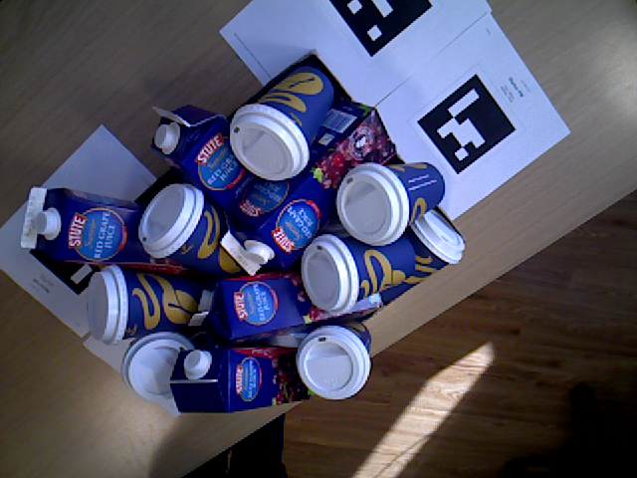
Bin-Picking Dataset
Multiple instances inside bin
Severe Occlusions
Scanning window contains parts from multiple instances
Found in Industrial Setups
~100 test images per scene
1st Fully Annotated bin-picking scenario

Slide 15
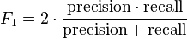
Train
Only 3D model provided
Rendered Annotated Images are used
Evaluation
PR curves, since multiple objects are present
True positive – Point to point average distance from ground-truth below a threshold
F1 score

Slide 16
Challenge Technical University Dresden (TUD) Articulated Object Challenge

Slide 17
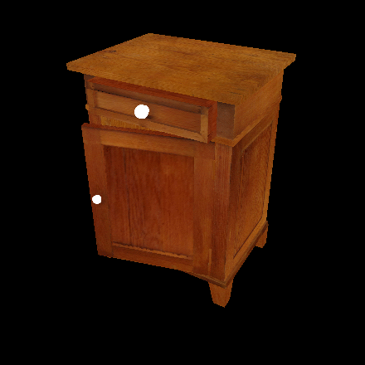
The Challenge
Estimate pose of articulated objects
Multiple parts connected by:
Prismatic joints
Revolute joints
High dimensional search space
6 + N for object with N joints
Heavy self occlusion

Slide 18
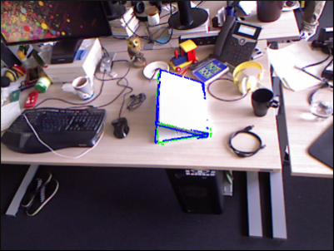
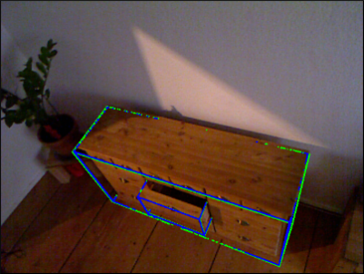
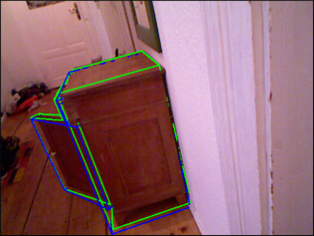
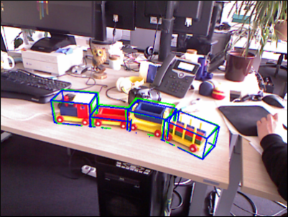
The Dataset
4 articulated objects
11 individual parts
8 RGB-D test sequences (2 for each object)
7000+ images
Realistic and cluttered backgrounds
Different scales
3D models for all individual parts
Text files describing joint connections
[Michel2015]: Frank Michel, Alexander Krull, Eric Brachmann, Michael. Y. Yang, Stefan Gumhold, Carsten Rother:
Pose Estimation of Kinematic Chain Instances via Object Coordinate Regression. BMVC 2015.

Slide 19
The Procedure
Training is open
All data except our test sequences
Send us your results and we will calculate the error according to different metrics:
The average distance criterion [Hinterstoisser2012]
5cm, 5deg [Shotton2013]
Bounding box IOU
The pose of an object is correct, if all parts are correct.
[Hinterstoisser2012]: Stefan Hinterstoisser, Vincent Lepetit, Slobodan Ilic, Stefan Holzer, Gary R. Bradski,
Kurt Konolige, Nassir Navab: Model Based Training, Detection and Pose Estimation of Texture-Less 3D Objects in Heavily Cluttered Scenes. ACCV 2012
[Shotton2013]: Jamie Shotton, Ben Glocker, Christopher Zach, Shahram Izadi, Antonio Criminisi, Andrew Fitzgibbon:
Scene Coordinate Regression Forests for Camera Relocalization in RGB-D Images. CVPR 2013

Slide 20
Challenge Technical University Dresden (TUD) Occluded Object Challenge

Slide 21
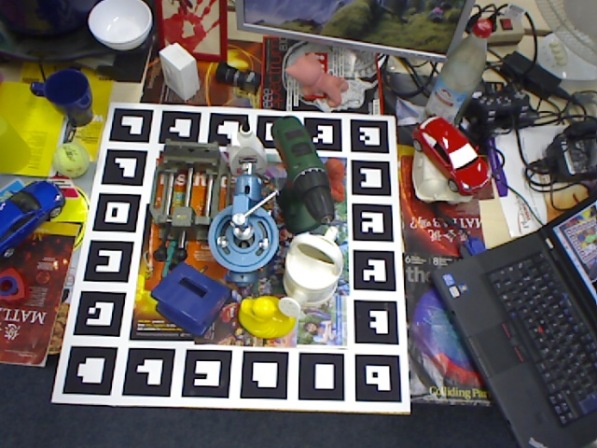
The Challenge
Estimate the 6D pose from single RGB-D images
Focus on the estimation of the pose:
It is known which objects are present
3D models of the objects are provided
High levels of occlusions
Cluttered environment
[Hinterstoisser2012]
[Hinterstoisser2012]: Stefan Hinterstoisser, Vincent Lepetit, Slobodan Ilic, Stefan Holzer, Gary R. Bradski,
Kurt Konolige, Nassir Navab: Model Based Training, Detection and Pose Estimation of Texture-Less 3D Objects in Heavily Cluttered Scenes. ACCV 2012

Slide 22
The Dataset
8 additionally annotated ([Brachmann2014]) objects for sequence from [Hinterstoisser2012]
1000+ Images
[Hinterstoisser2012]: Stefan Hinterstoisser, Vincent Lepetit, Slobodan Ilic, Stefan Holzer, Gary R. Bradski,
Kurt Konolige, Nassir Navab: Model Based Training, Detection and Pose Estimation of Texture-Less 3D Objects in Heavily Cluttered Scenes. ACCV 2012
[Brachmann2014]: Eric Brachmann, Alexander Krull, Frank Michel, Stefan Gumhold, Jamie Shotton, Carsten Rother:
Learning 6D Object Pose Estimation using 3D Object Coordinates. ECCV 2014

Slide 23
The Procedure
Training is open
All data except our test sequences
Send us your results and we will calculate the error according to different metrics:
The average distance criterion [Hinterstoisser2012]
5cm, 5deg [Shotton2013]
Bounding box IOU
[Hinterstoisser2012]: Stefan Hinterstoisser, Vincent Lepetit, Slobodan Ilic, Stefan Holzer, Gary R. Bradski,
Kurt Konolige, Nassir Navab: Model Based Training, Detection and Pose Estimation of Texture-Less 3D Objects in Heavily Cluttered Scenes. ACCV 2012
[Shotton2013]: Jamie Shotton, Ben Glocker, Christopher Zach, Shahram Izadi, Antonio Criminisi, Andrew Fitzgibbon:
Scene Coordinate Regression Forests for Camera Relocalization in RGB-D Images. CVPR 2013

Slide 24
Challenge Technical University Graz & EPFL 3D Rigid Tracking from RGB Images Challenge

Slide 25
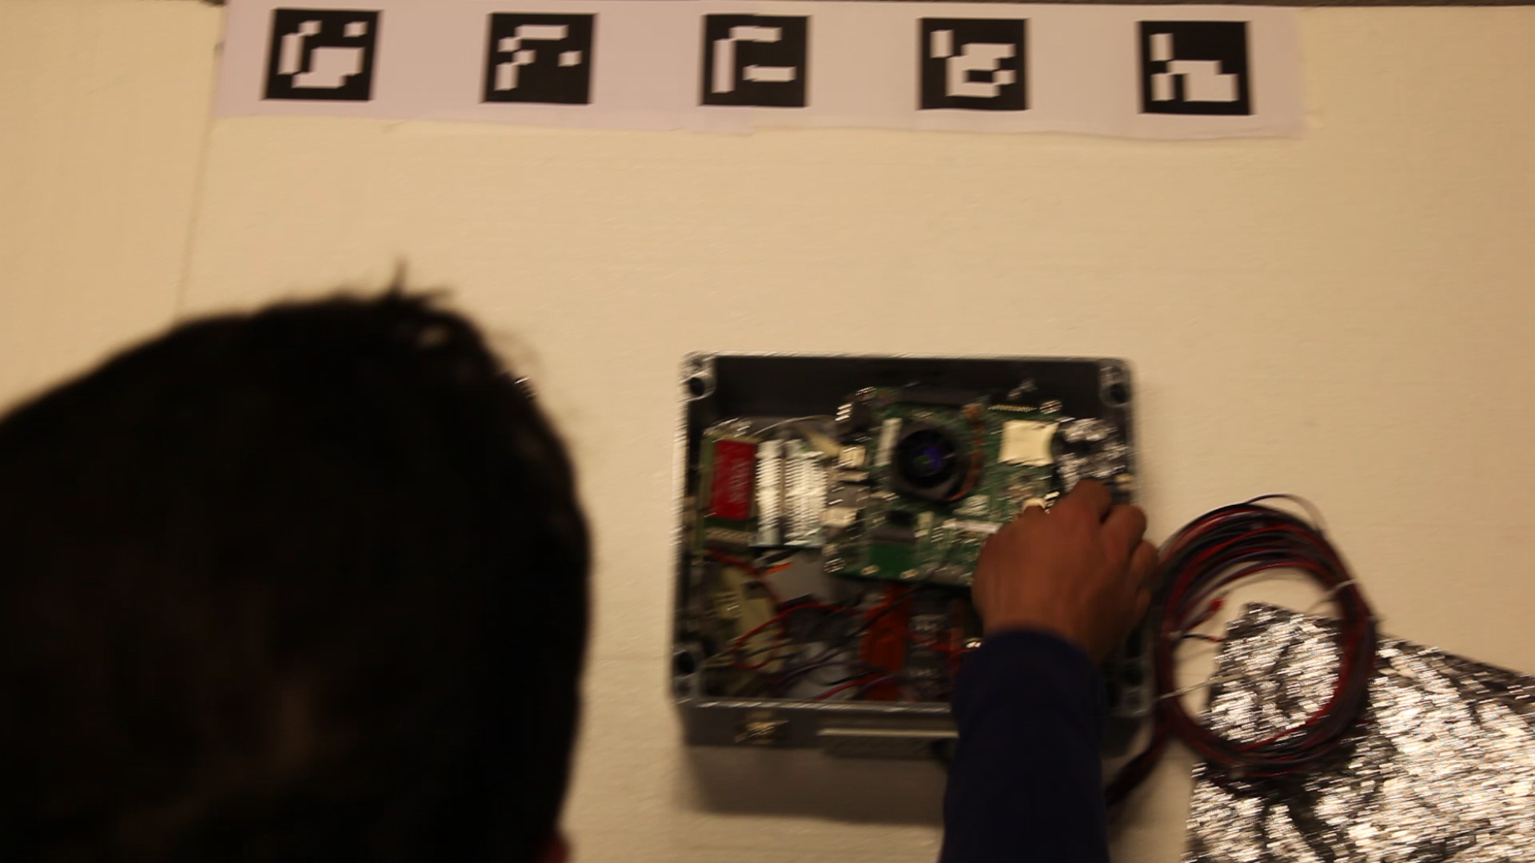

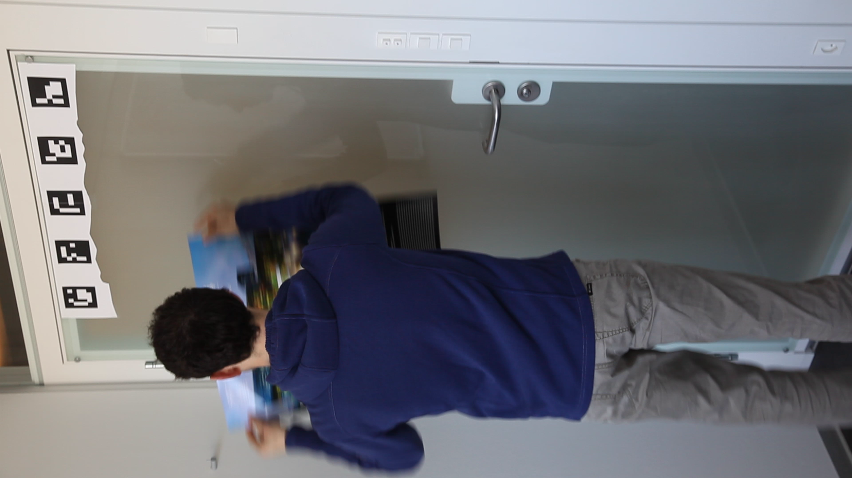

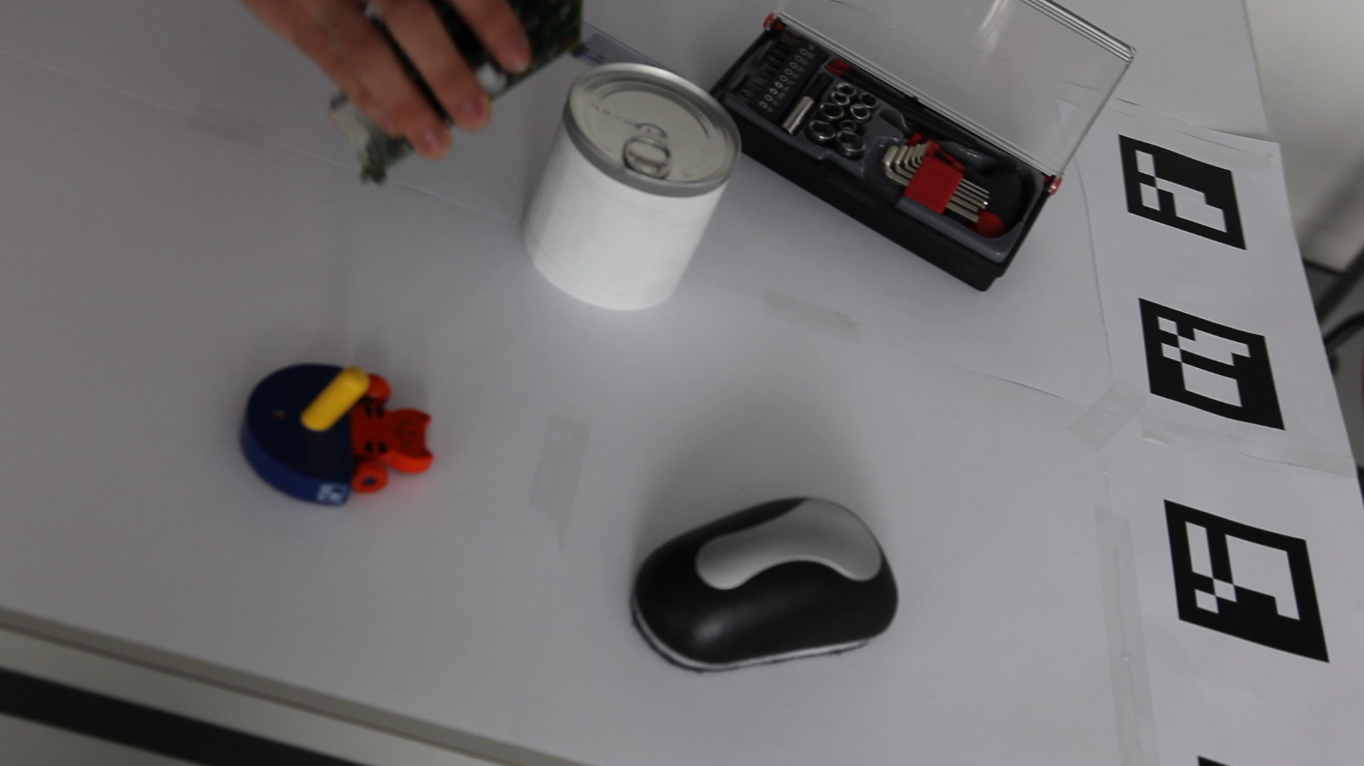
The Dataset
Monocular RGB images (NO Depth!)
3 rigid, poorly textured, occluded objects
Simple CAD model for each object
Occlusions come from:
User interaction
Object moving against cluttered background
Distractor objects
CHALLENGE:
Recover 3D pose (6 DOFS) of the target object on each frame of the testing video sequences

Slide 26
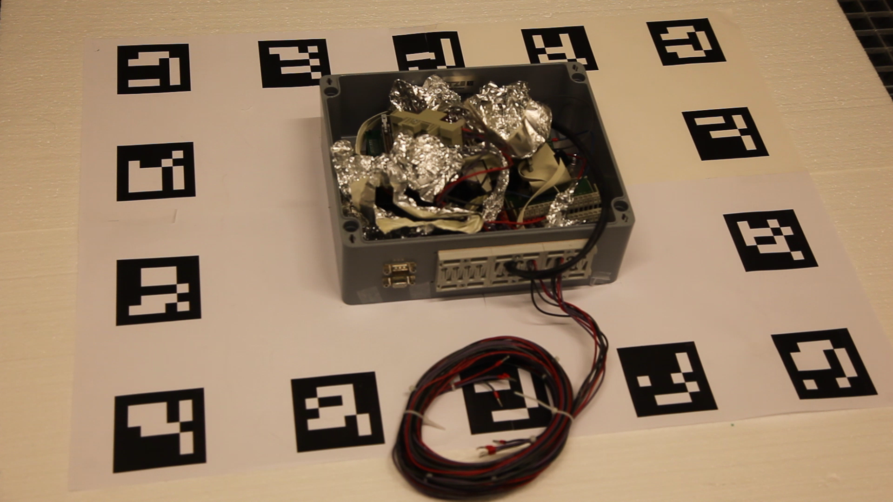
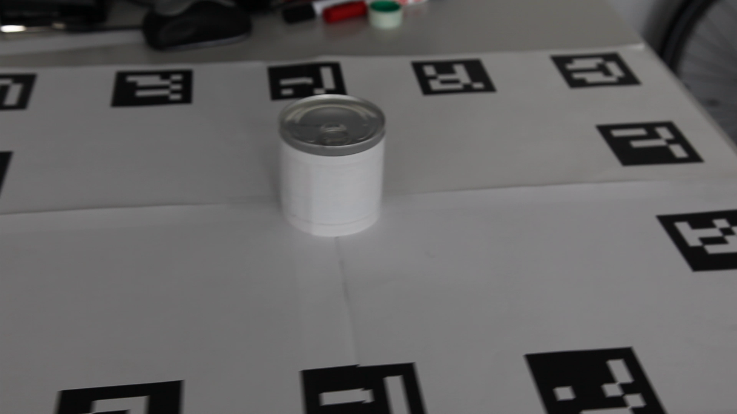
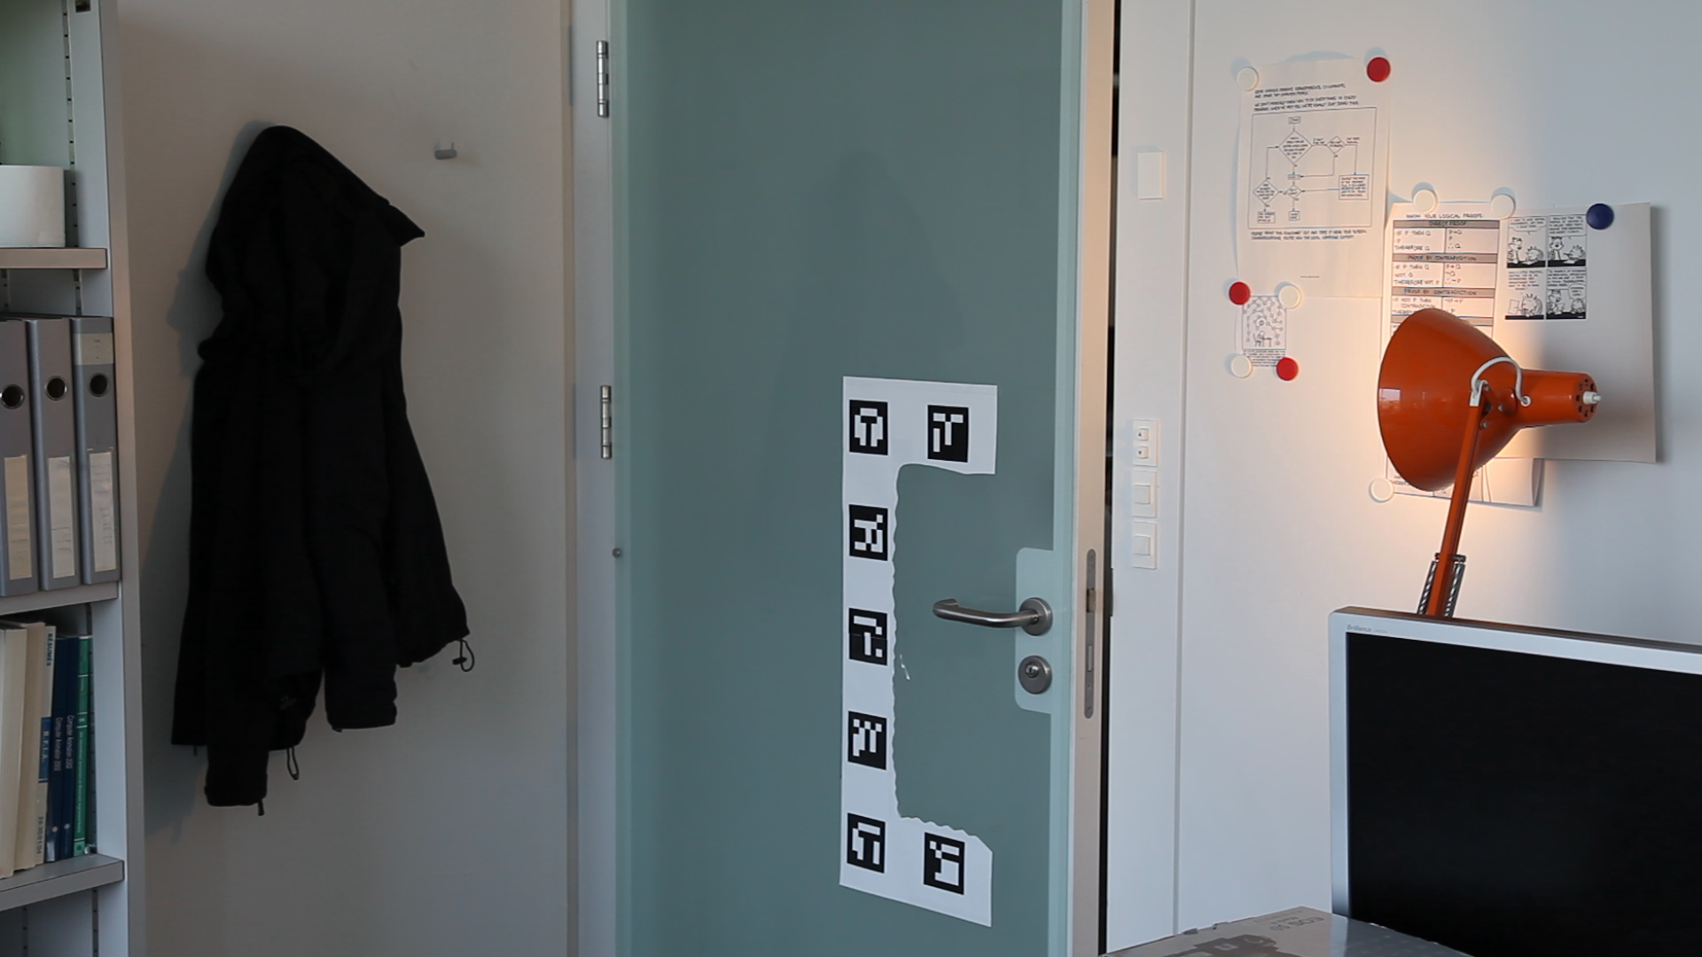
Training & Testing
Training set
Pose ground truth retrieved from grid of markers registered wrt the object
Object showed with several static distractor objects
Testing set
Pose ground truth retrieved from grid of markers far from the object and manually refined
Dynamic user interaction, distractor objects are moving, light and background changes

Slide 27
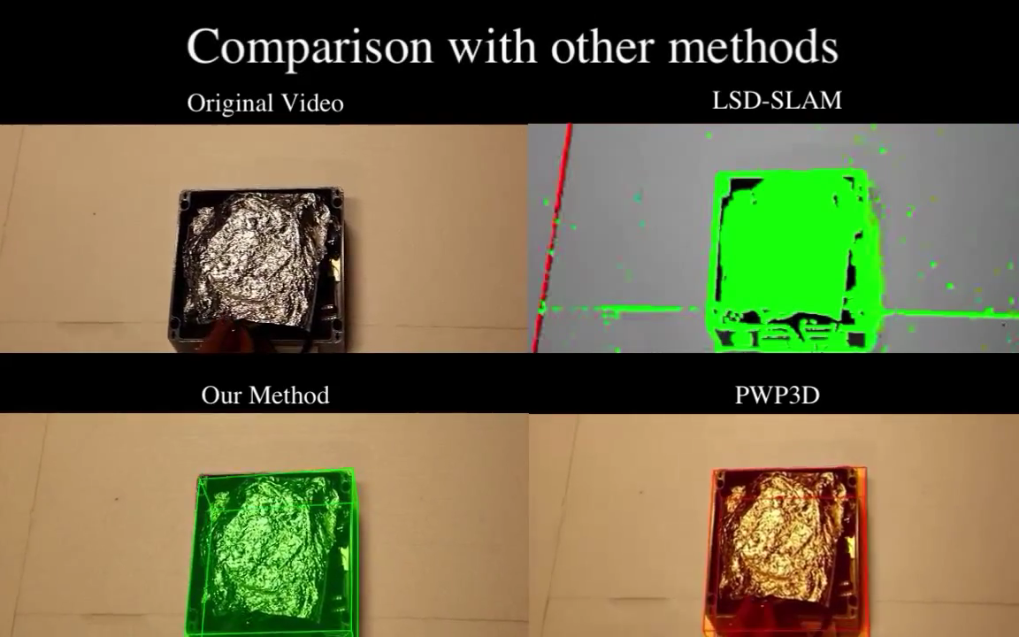
Testing Set - Box

Slide 28
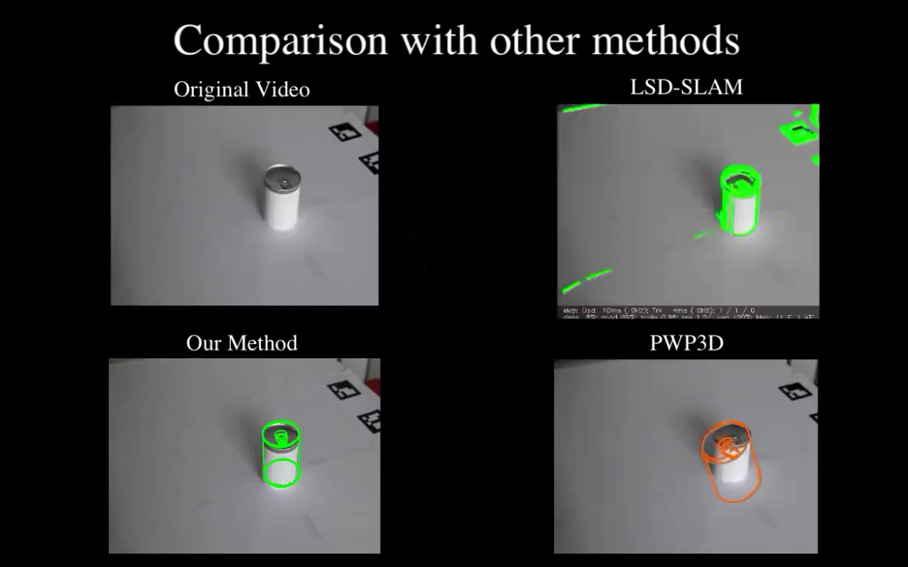
Testing Set - Can

Slide 29
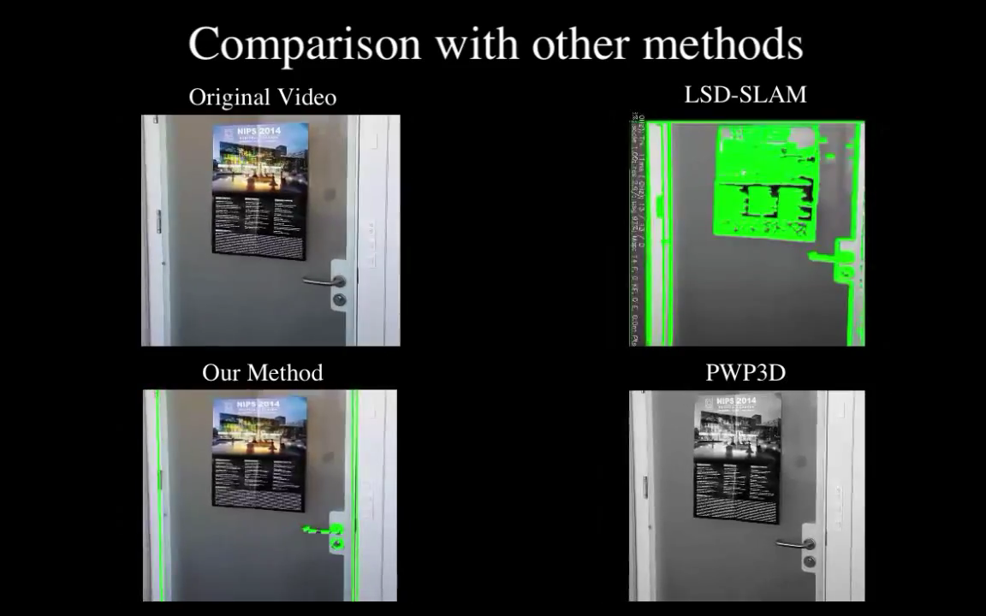
Testing Set - Door

Slide 30
Evaluation Metric
Align trajectories if needed *
Compute the rotation and translation components of the absolute pose error for each frame.
Compute their empirical Cumulative Distribution Function
Compute the AUC score for each component
* Sturm, et al. A benchmark for the evaluation of RGB-D SLAM systems. IROS 2012

Slide 31
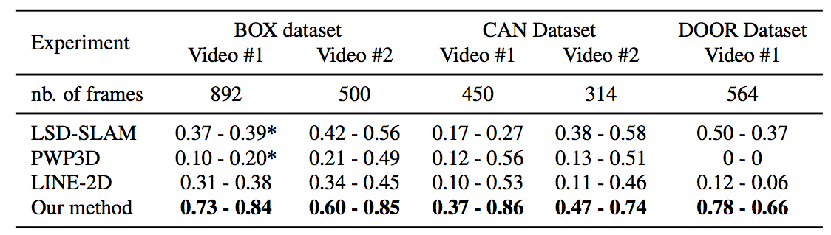
Results
Methods with * are restarted at roughly half of the sequence
Crivellaro, Alberto, et al. "A Novel Representation of Parts for Accurate 3D Object Detection and Tracking in Monocular Images.” ICCV 2015.
Try it your self!
http://cvlab.epfl.ch/data/3d_object_tracking

Slide 32

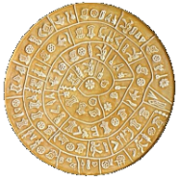

Challenge Czech Technical University T-LESS A new RGB-D dataset and evaluation protocol for detection and 6D pose estimation of texture-less objects http://cmp.felk.cvut.cz/t-less
CTU
Prague
FORTH
Heraklion
TU
Wien

Slide 33

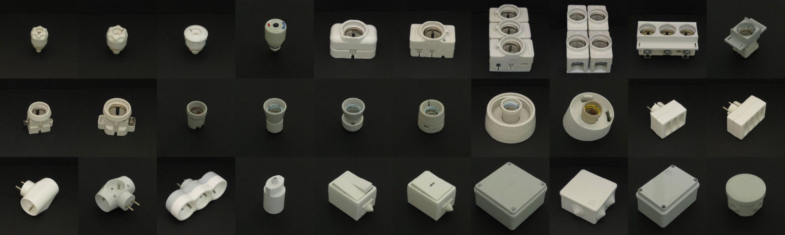
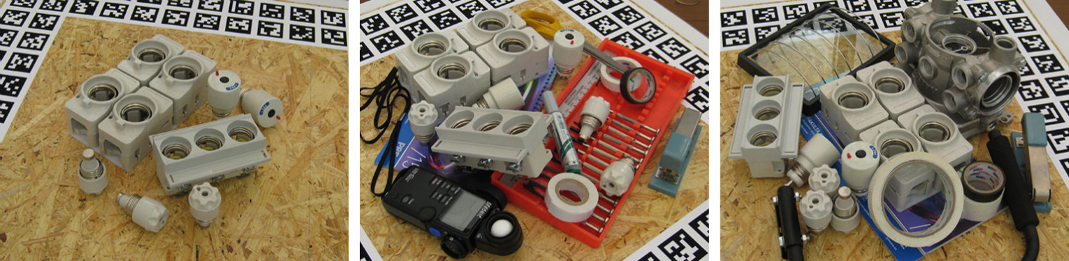
T-LESS: Key Features
Relatively small objects often very similar in shape and color
Test images include significant clutter and occlusions
Accurate ground truth 6D pose for all known objects in each image
Data from three synchronized and mutually calibrated sensors (a structured-light depth sensor, a time-of-flight depth sensor, and a high-resolution camera)

Slide 34
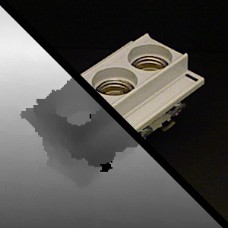
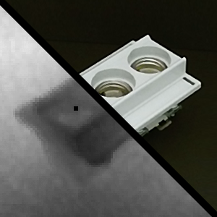
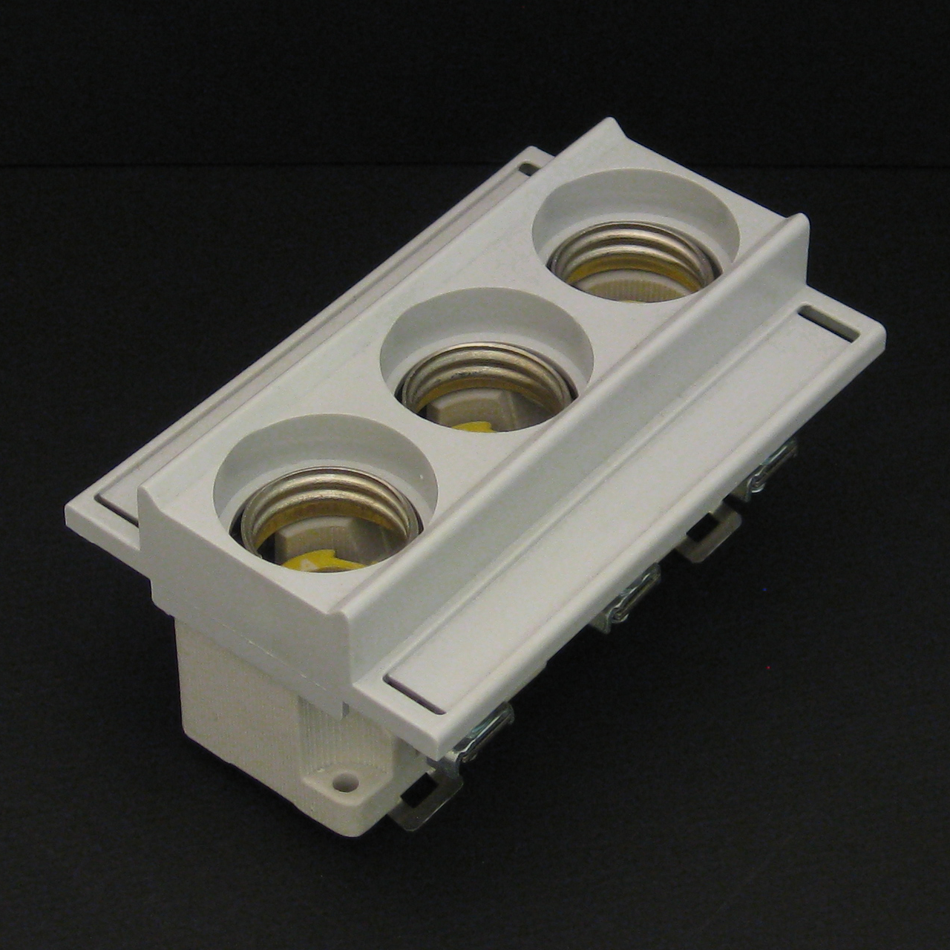
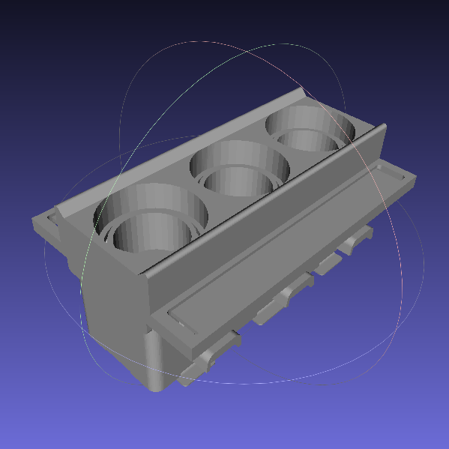
T-LESS: 30 Texture-less Objects
RGB-D & RGB training templates depicting objects from a uniformly sampled full view sphere (10° step in elevation and 5° in azimuth) ➡ 1278 templates per object from each sensor
Each template is annotated with a 6D pose of the object
Two 3D mesh models for each object:
Manually created
Automatically reconstructed (TU Wien)
300x300 px RGB-D template from Primesense CARMINE 1.09
300x300 px RGB-D template from Kinect v2
1280x1280 px RGB template from Canon IXUS 950 IS
Manually created 3D model

Slide 35




T-LESS: Capturing Setup
Sensors (synchronized and mutually calibrated):
Primesense Carmine 1.09 (Short Range) registered RGB-D images (RGB:1280x1024 px, D:640x480 px)
Microsoft Kinect v2 registered RGB-D images (1920x1080 px)
Canon IXUS 950 IS high resolution RGB images (3264x2448 px)
Sensors fixed on an arm with adjustable tilt
A turntable with a marker field for camera pose estimation (the vertical markers enable estimation from low elevations)
A shield to ensure black background in training templates (it is removed for capturing test data)
A strong reflector to increase ambient light

Slide 36
Program
08:30-09:00 Opening / introduction of challenges
09:00-09:30 Organiser's talk 1, New Object and Part Representations for 3D Pose Estimation, Vincent Lepetit, TU Graz
09:30-10:00 Organiser’s talk 2, UoB Highly Occluded Object Challenge, Krzysztof Walas (joint work with Ales Leonardis), Poznan University of Technology
10:00-10:30 Coffee break
10:30-11:00 Invited talk 1, Distributions of Diverse Features For Single and Multiple-View Robot Vision, Justus Piater, University of Innsbruck
11:00-11:30 Organiser’s talk 3, Learning 6D Object Pose Estimation and Tracking, Alexander Krull (joint work with Carsten Rother), TU Dresden
11:30-12:00 Invited talk 2, 3D Object Detection and Pose Estimation, Yu Xiang (joint work with Silvio Savarese), University of Michigan
12:00-13:30 Lunch break
13:30-14:00 Spotlights
14:00-15:00 Poster session (extended abstracts)
15:00-15:30 Coffee break
15:30-16:00 Organiser's talk 4, Recognition and 6D Localization of Textureless Objects, Jiri Matas, Czech Technical University
16:00-16:30 Organiser’s talk 5, Object Pose and Next-Best-View Estimation by Randomised Forests, Tae-Kyun Kim, Imperial College London
16:30-17:00 Invited talk 4, 3D Object Pose and Shape, Kostas Daniilidis, University of Pennsylvania
17:00-18:00 Discussions / awards / closing

